Slide 1


Breakout session “The Weight is over” Part 2
Dr. Debbie Smith.
EMEA Chief Medical Officer

Slide 2



Swiss Re IP Claim Deep Dive key stats
RECAP
n=277
Reviewed by team of 6 doctors, clinical team, claims assessors, and actuaries.
Unselected sample, claim durations up to 5 years
1%
Underweight
11% Normal range
10%
Overweight
18% Obese
60% No information available
Further drill down into 12+ month IP claim cohort.
KEY
FINDING
From analysing co-morbidities, we concluded that in 18.4% of long-term IP claims obesity was the factor regarded as the PRIMARY DRIVER of claim – but wasn’t listed as a health condition in 75% of cases.

Slide 3
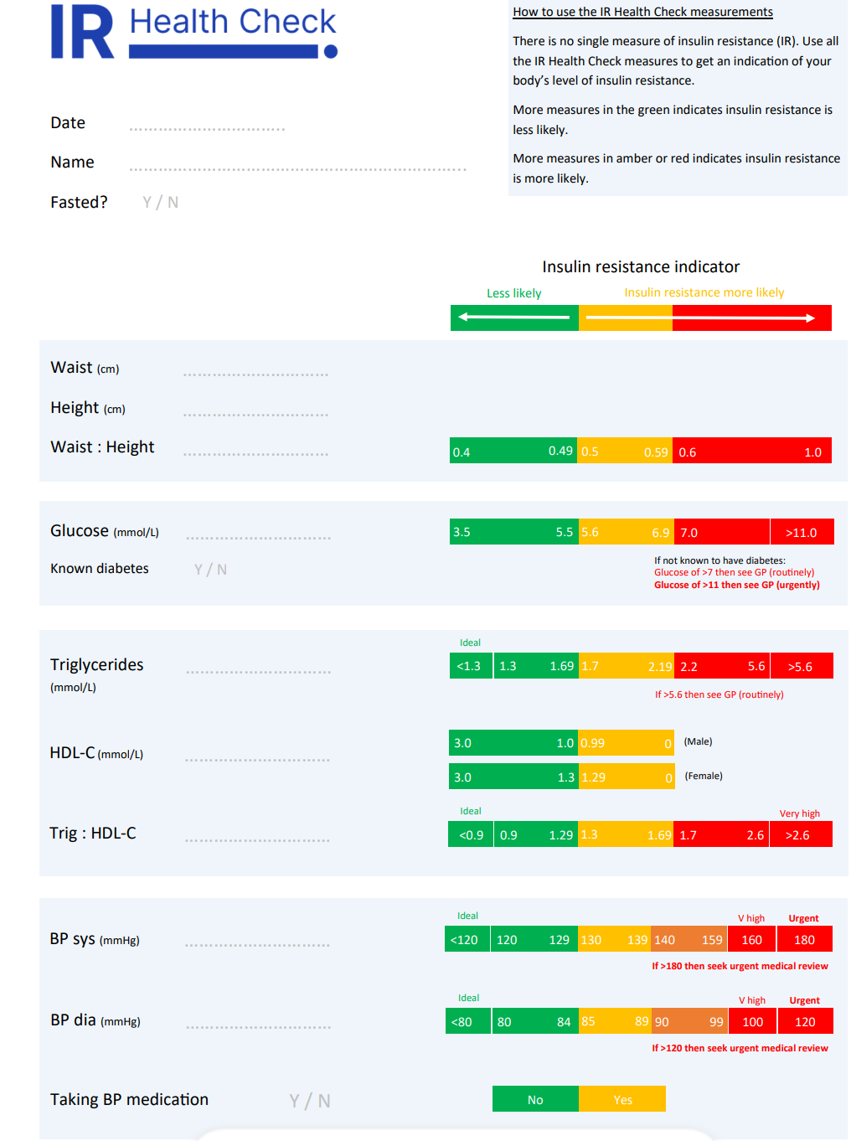
Pilot study
Identification of suitable claimants
Triage for suitability
Treatment & follow up
Notes:
Identification – claim form and claims handler script – non stigmatising. Risk markers for insulin resistance would include waist to height ratio, trigs, blood pressure and softer markers such as sleep, exercise tolerance
Triage – selection interview and questionnaire, baseline bloods
Treatment & Follow up – 1-week residential course (educational content and counselling), online support group, monitoring via bloods and body measurement

Slide 4
Pilot study – diving deeper
Identification
Exclusion criteria
Motivation
28 day plan & review
Treatment & follow up
Autonomy
Notes:
Identification – claim form and claims handler script – non stigmatising. Exploration of possible exclusion criteria
Triage – 28 day plan
Treatment & Follow up – 1 week residential course (educational content and counselling), online support group, monitoring via bloods and body measurement
KEY FACTOR – was nutritional knowledge the issue, or eating addiction?

Slide 5
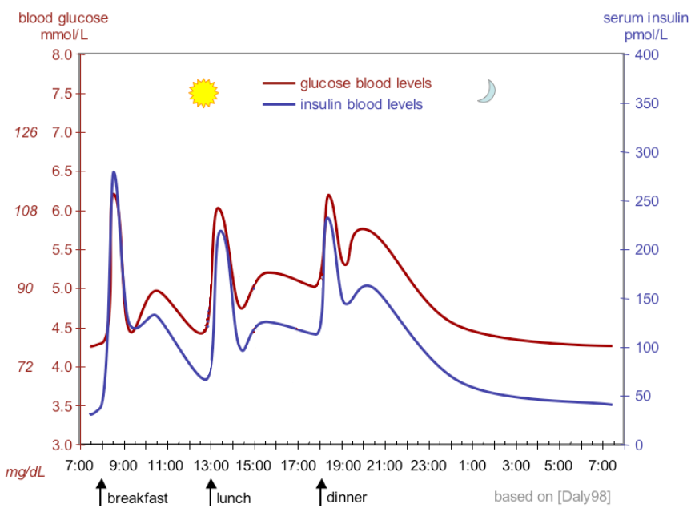
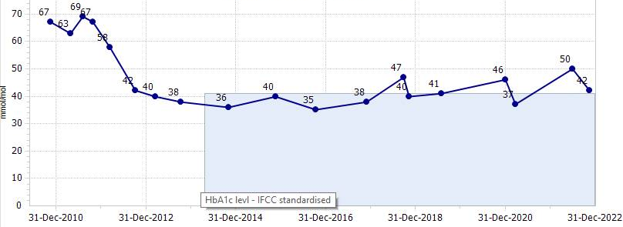
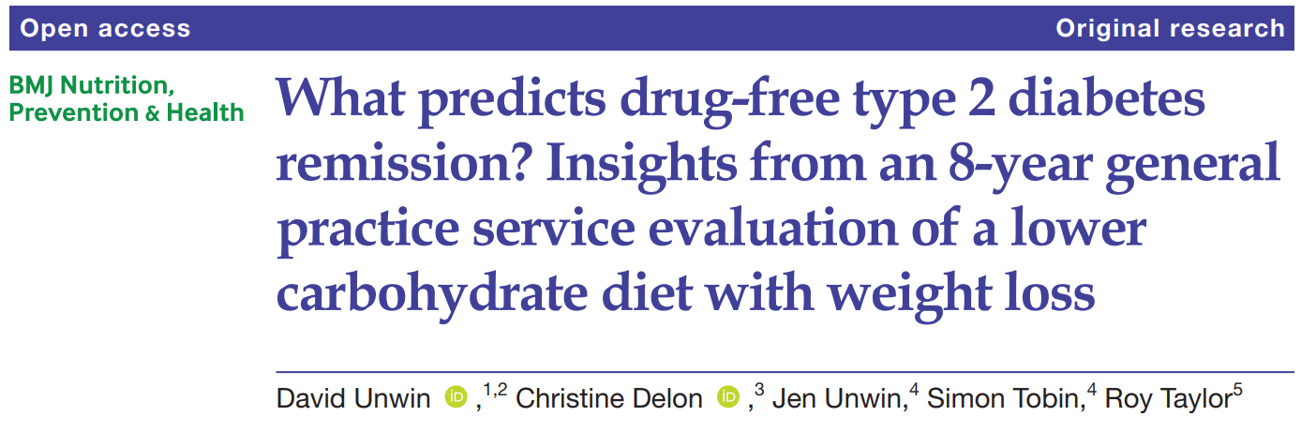
You’re at higher risk of insulin resistance, what next?
hyper- insulinemia
Reduce insulin resistance by
Reducing high insulin levels by
Reducing blood glucose levels by
Reducing/changing carbohydrate intake
insulin resistance
HbA1c in mmol/mol 2010-2022
Notes:
So, what to do….well it seems rather obvious doesn’t it? We try to reverse that list of bad things that lead to metabolic syndrome and stop the insulin resistance process in it’s tracks.
Here we see the HbA1c levels in a type 2 diabetic once they adjust their carbohydrate intake. This is one of David Unwin’s patients, and a man who speaks for us at various conferences to share his experiences

Slide 6
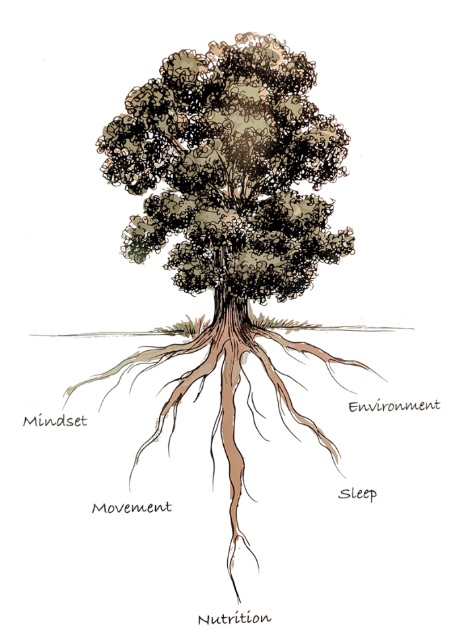

The Five Roots
Nutrition
Movement
Sleep
Mindset
Environment
Notes:
The main themes are not rocket science – so it’s about WHAT we eat, how much we move, how we sleep, how our mindset affects our ability to change, and how our environment affects that too.

Slide 7
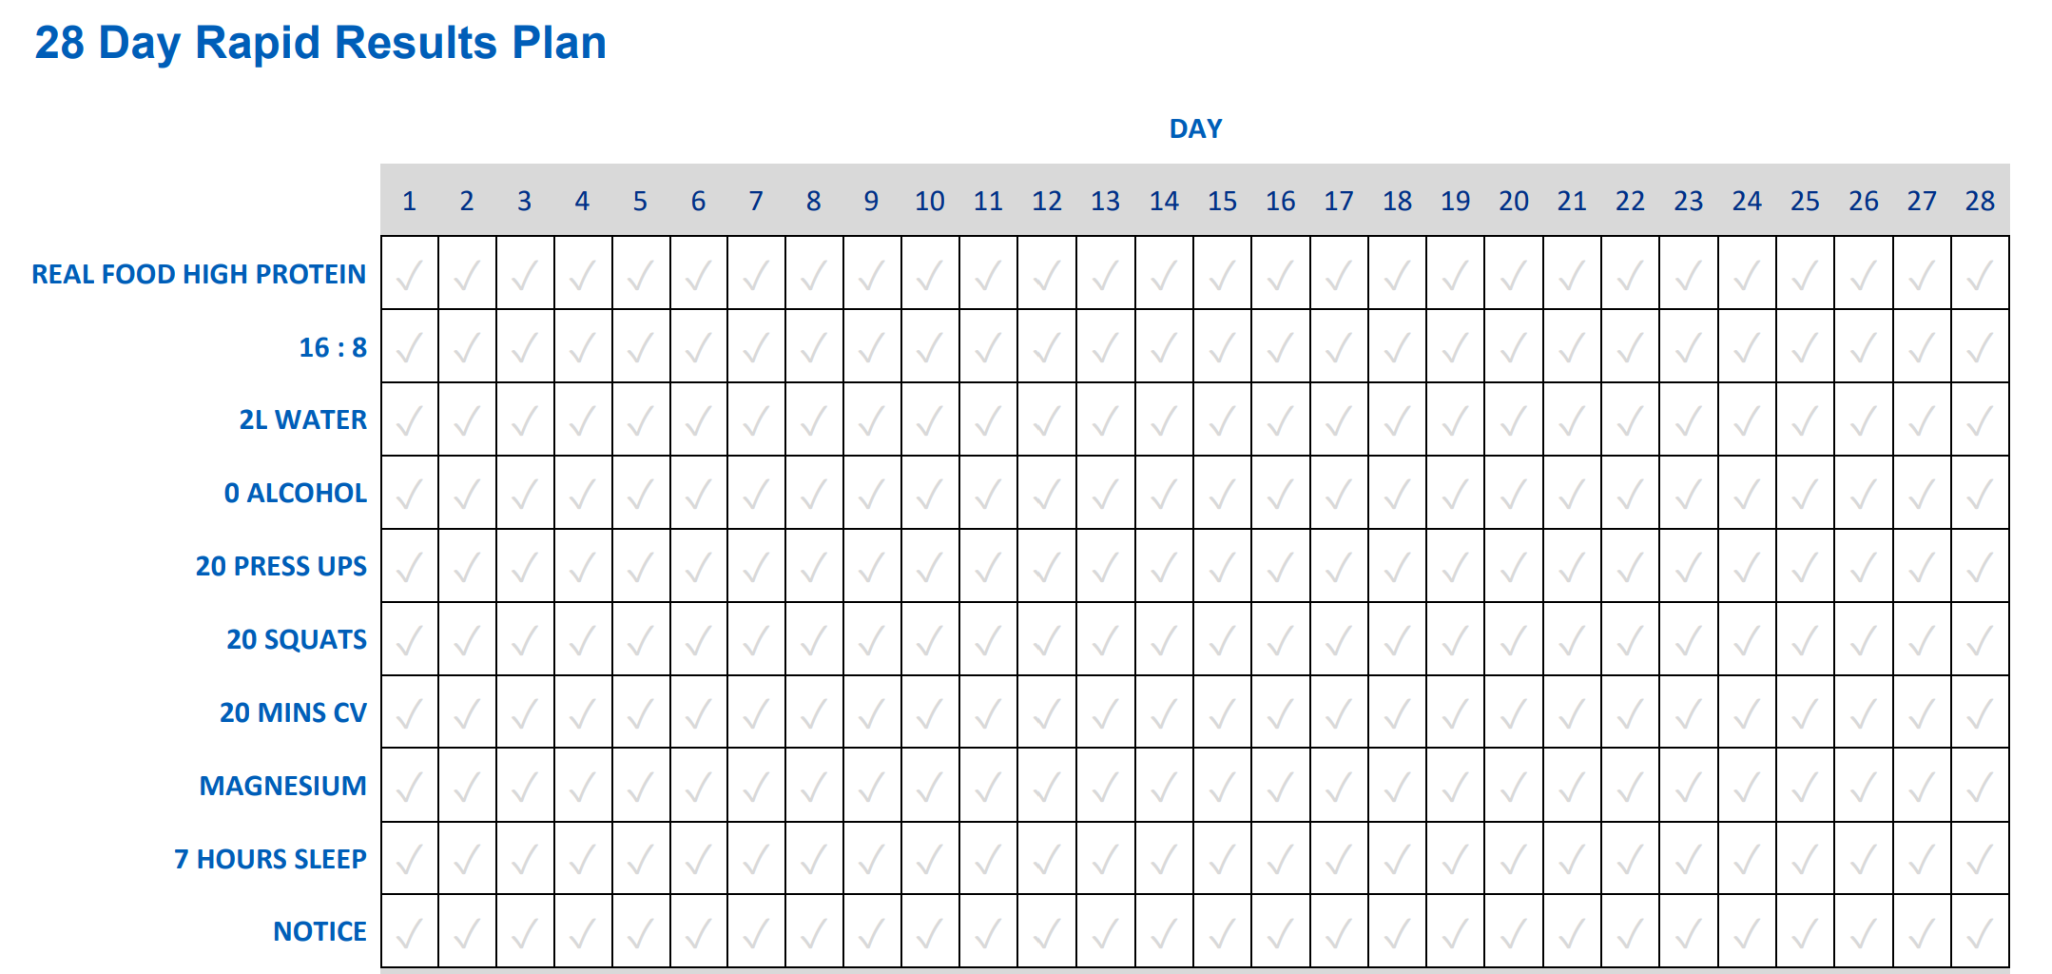

Slide 8
Simple nutritional aims
Low carb – aim for <30g/day
Limit eating to a 6 or 8 hr window
Eat clean
Forgive lapses – this is a lifestyle and not a diet
Sounds straight forward…but does it work?

Slide 9
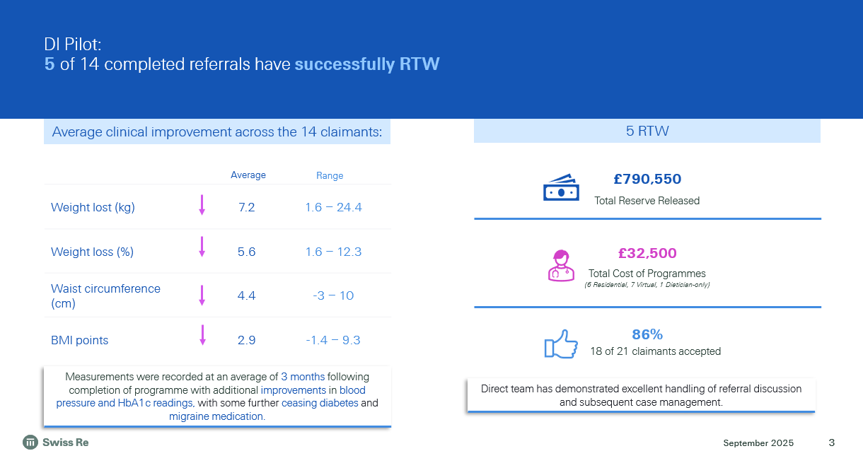

Notes:
Remember these were all claimants who had been off work over 12 months, and were predicted to stay on claim until normal retirement age

Slide 10
DI Pilot: 5 of 14 completed referrals have successfully RTW
Residential (1 week stay)
Virtual
RTW
Ceased – DOI Not Met
Program Completion
VR Support
+
|
+
+
+
+
+
|
|
|
+
|
|
+
|
3
6
9
12
Months
Notes:
4 out of the 5 RTW’s went back in first 3 months near enough
3 of those needed some vocational rehab to help them feel confident enough to return.
(1) Res. program completed in full. RTW 1 month later w/ W2W (2) RTW took place before Res started. Good outcome as RTW sustained (3) Full RTW 4 months post-res program (4) Did not complete res. program in full (went home early). Program to be delivered virtually. W2W involved (5) Attend res. program Oct '24. Ergocom on hold Unclear from file what support is being provided by CG (6) Res program completed March 2024, has had 12 months f/up support with this remaining open door policy. W2W involved. (further weight loss required for knee surgery) (7) 2 months into Virtual program, clmt decided to end support, focus on medical complexity. Had support with Vitality360 (8) Virtual program, RTW at completion w/ Ergocom support (9) Virtual completed. Clmt wished to continue independently at program completion (10) Has completed 12wk virtual, case ongoing, CG support remains open, currently at month 6 (11) Dietician-only support provided over 3 months, ending October 24. RTW May '25 w/ Ergocom (12) Virtual completed. Complex medically but support remains available. At month 9 currently completion of 20week CG input, DOl not met. Ergocom involved.

Slide 11
Unselected cohort - learnings
Exclusion criteria
Readiness to engage
Educational need
v
Food addiction
F2F v virtual
Peer support & recipes
Notes:
The only medical exclusion criteria that remained were
serious mental health disorders (although metabolic psychiatry is evolving, so this may change), eating disorder (bulimia)
musculoskeletal disorders where joint destruction and pain unlikely to be alleviated by weight loss sufficiently to RTW
The 14 cases involved morbid obesity, so ranged from a BMI of 35 with multiple co-morbidities to BMI’s over 50. Could refine later, but why exclude some?
Early worries about carer responsibilities (we’d had multiple claims where heavy responsibilities for unwell parents or children were adding complexity) allayed, far more important to contemplate the next point, which is
Readiness to engage – learnings included that we could have identified those who were reluctant to engage as being likely failure to engage fully
With the addition of the 28 day self initiated trial this means that spend on the “expensive component” can be avoided or deferred until success more likely
Using the 28 day “test” from the start would have increased the ratio of successful RTW against costs
Identification of claimant needs – early successes were notable due to nutritional learnings but longer tails were noted when food addiction was involved. The service provided both aspects of dietary education, using the low carb method, as well as counselling if food addiction was present.
The costs described included a 1 week residential stay – which gave some issues in terms of being able to travel, scalability and price.
Now we’ve moved to a virtual programme, with retained access to F2F for v selected cases, so costs will reduce further.
Initially the plan was for peer support, and they would be offered whatsapp groups to chat. This formalised into a wish for menu suggestions, so additional materials were added and long term plan is for a website to support

Slide 13

"It's amazing, my employer not only supported me with the money but actually really wanted to help with my metabolic health."
"I’ve lost 10kg in 6 weeks! This programme has been a game changer for me".
Notes:
Many claimants provided testimonials they were happy to share on their experience.
Exceptional feedback from claimants on their experience and outcomes. Lots of quotes shared with us these are just two. Good publicity with Cover customer care awards finalist position- innovative in the market

Slide 14
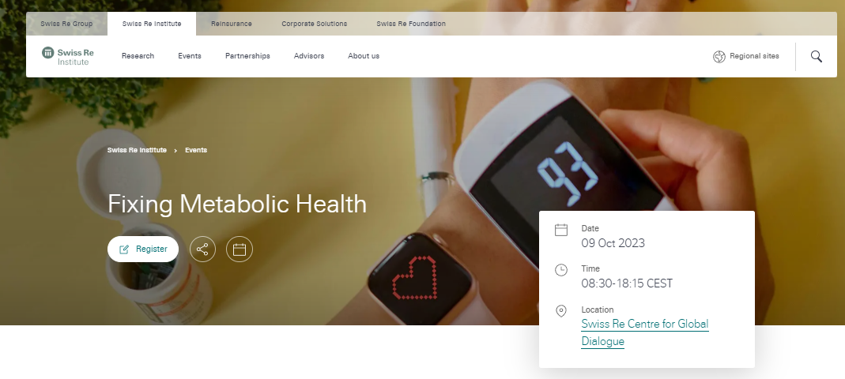
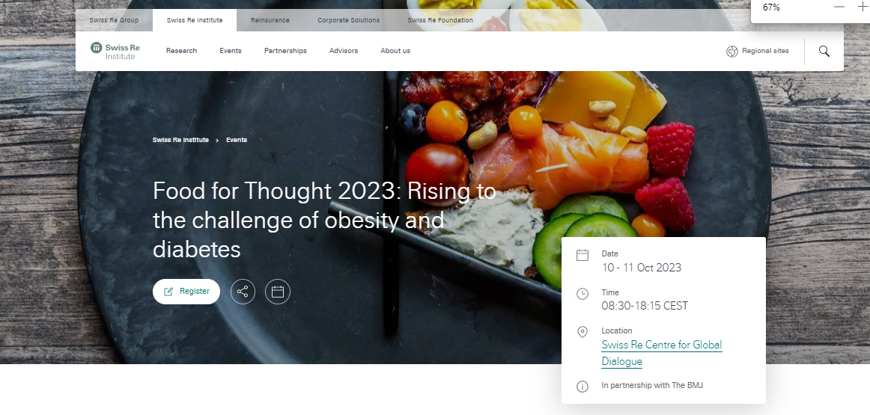
Swiss Re’s initiatives in this space
Relationships with Global experts
Finding best Programs/Partners
Launching Pilots
Multiple publications
Advocacy work
Notes:
so what is SR doing about this?

Slide 15
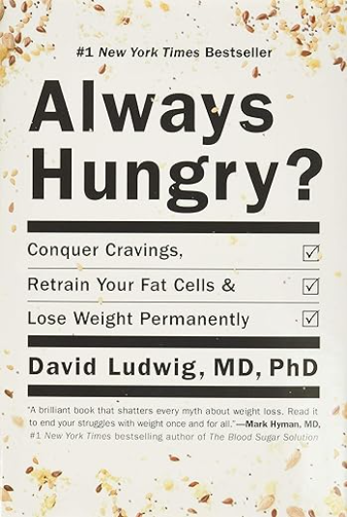
Food for thought
Notes:
not “lifestyle”, but different eating

Slide 16
Legal notice
©2025 Swiss Re. All rights reserved. You may use this presentation for private or internal purposes but note that any copyright or other proprietary notices must not be removed. You are not permitted to create any modifications or derivative works of this presentation, or to use it for commercial or other public purposes, without the prior written permission of Swiss Re.
The information and opinions contained in the presentation are provided as at the date of the presentation and may change. Although the information used was taken from reliable sources, Swiss Re does not accept any responsibility for its accuracy or comprehensiveness or its updating. All liability for the accuracy and completeness of the information or for any damage or loss resulting from its use is expressly excluded.

